Slide 1
Clustering Assignment
-by Harish J

Slide 2
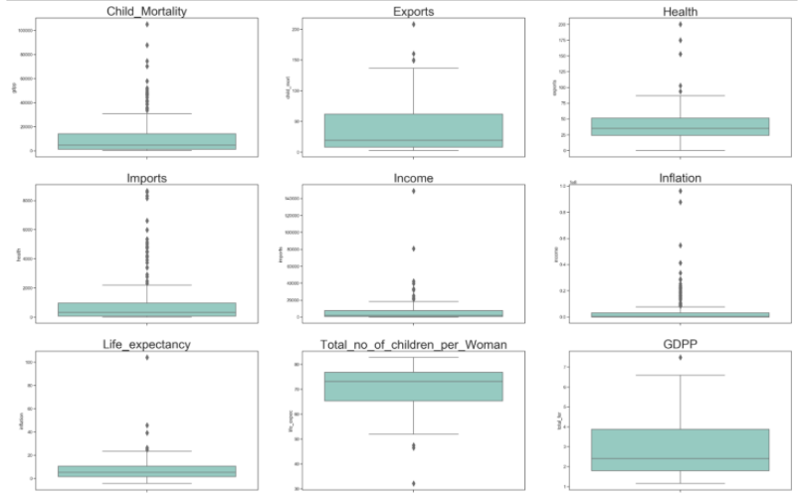
Data Visualization
Outliers Analysis
Plotted a boxplot for all the features to understand the existence of outliers in the dataset.
The inflation boxplot has less quartiles when compared to others.
Total_no_of_children_per_women has outliers on the bottom of the boxplot.

Slide 3
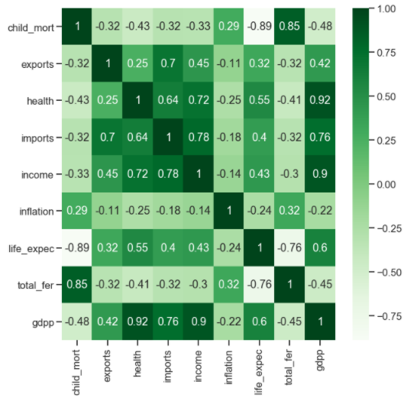
Correlation
Plotting a heat map to find the correlation between the variables on the dataset.
As a result some variables are high positive correlation and also high negative correlation.
Thus we can say the dataset is having multicollinearity.

Slide 4
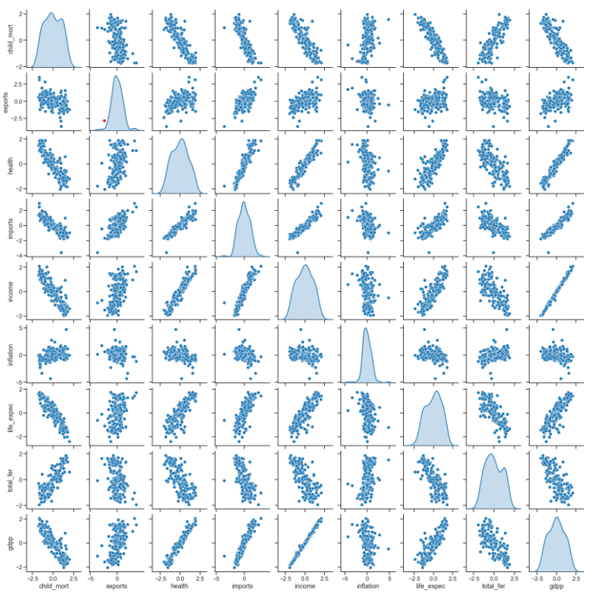
Pair plot after Rescaling the data
Plotted a pair plot on the dataset after
rescaling .
Rescaling helps to convert the data into
a specific range which helps the
accuracy in clustering algorithms.

Slide 5
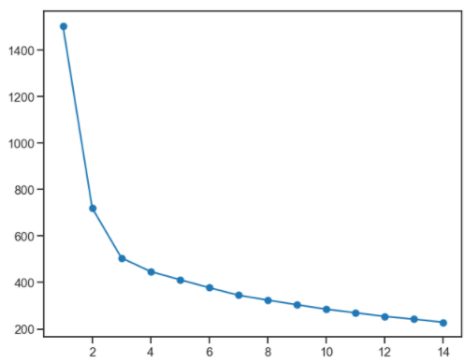
K-Means Clustering
To find Optimal no of clusters we use
SSD/Elbow curve method.
we have to select the value of k at the “elbow” ie the point after
which the distortion/inertia start decreasing in a linear fashion.
Thus for the given data, we conclude that the optimal number of
clusters for the data is 3.
Hence k-value = 3.

Slide 6
K-Means Clustering
Silhouette Analysis
We have found few silhouette scores of the given dataset,
For n_clusters=2, the silhouette score is 0.4083553693333196
For n_clusters=3, the silhouette score is 0.34850251239362645
For n_clusters=4, the silhouette score is 0.27301488301380217
For n_clusters=5, the silhouette score is 0.24083623893543307
For n_clusters=6, the silhouette score is 0.26741737502135443
For n_clusters=7, the silhouette score is 0.2190593898752462
For n_clusters=8, the silhouette score is 0.25692610741596333
According to above scores, we can conclude n_cluster = 3 gives a good score when compared to others.
Hence we can assume K-value = 3

Slide 7
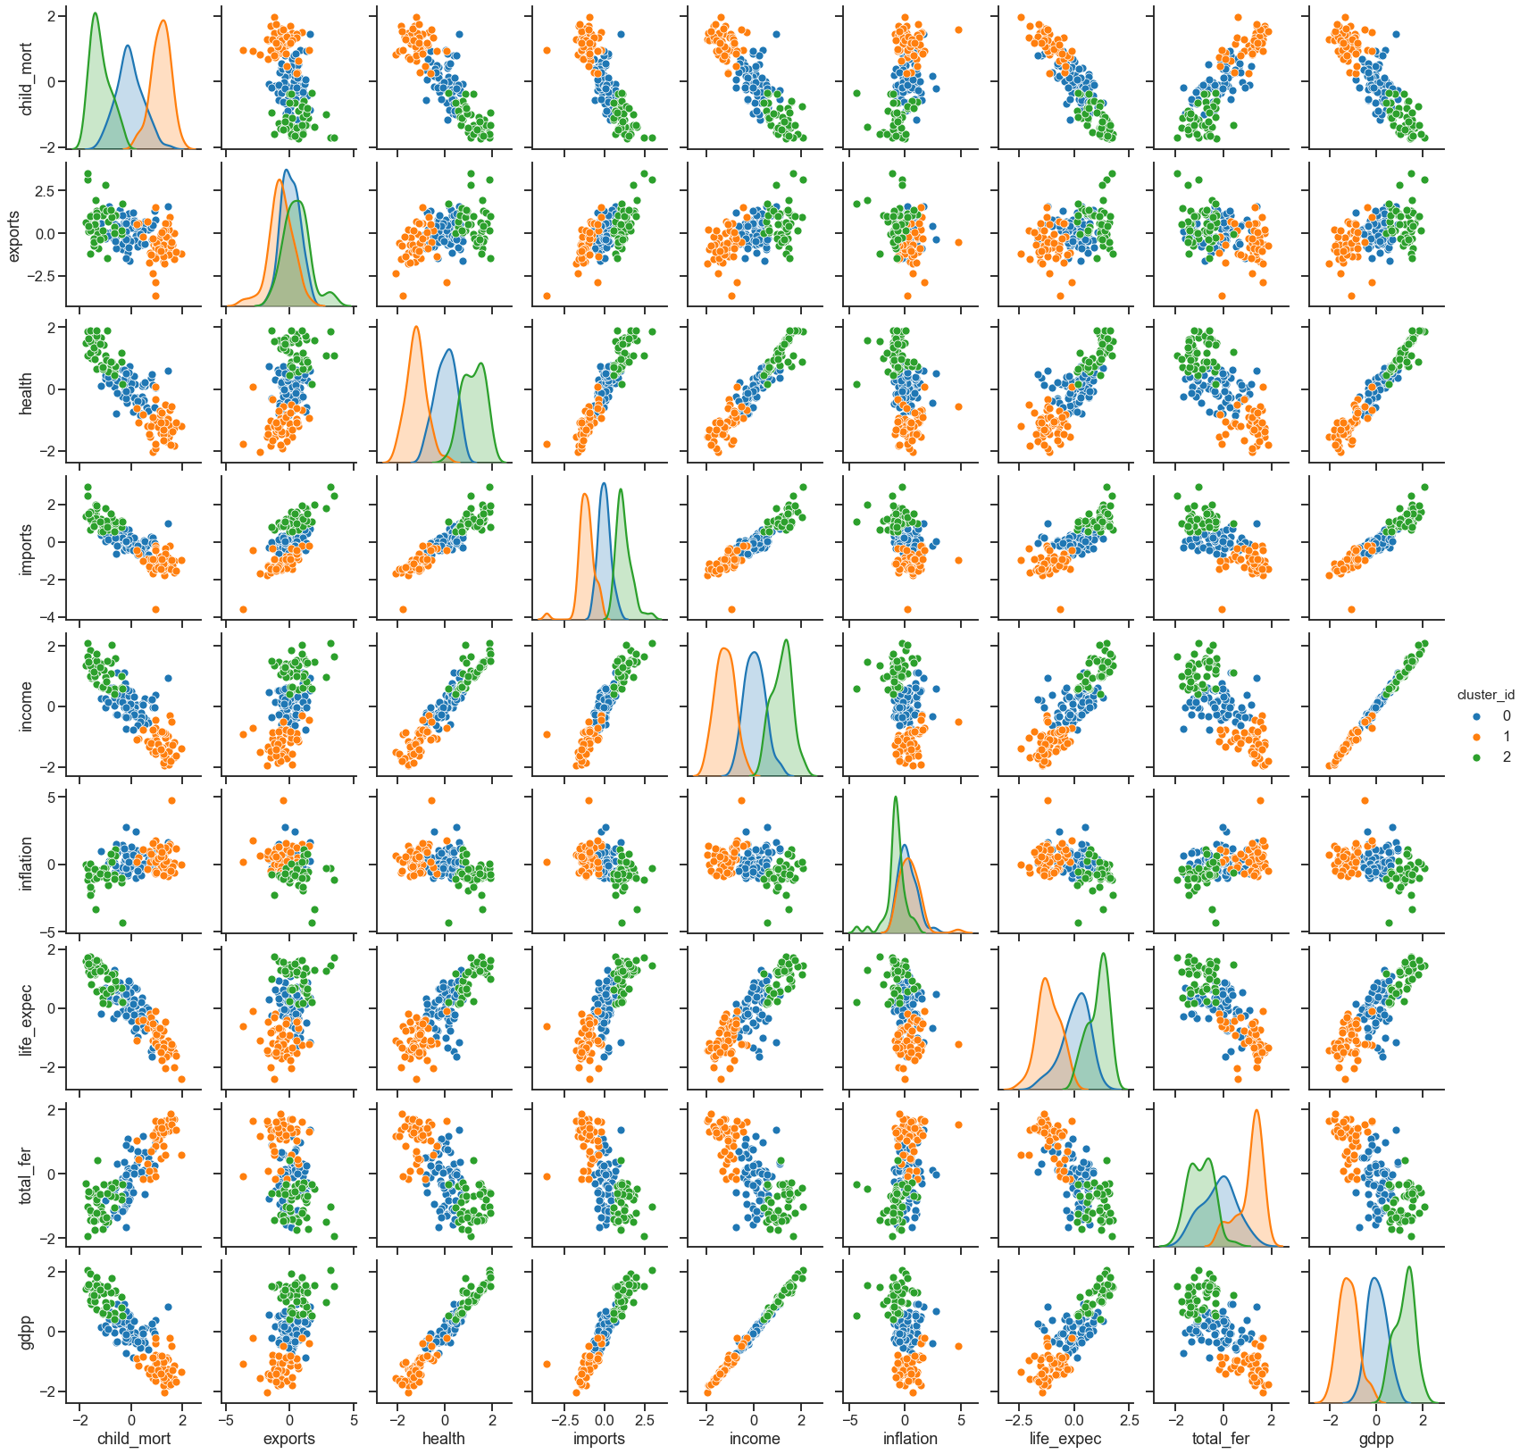
Pair plot with cluster id
Plotting a pair plot among all the variables
with respect to cluster id.
Blue – cluster 0
Orange – cluster 1
Green – cluster 2

Slide 8
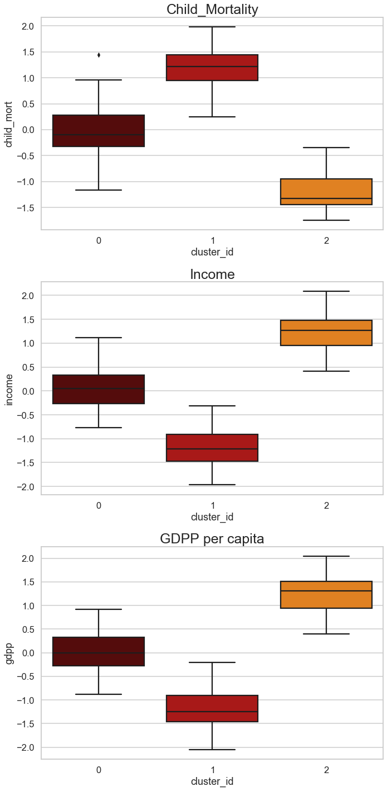
Box plot comparison among Child_Mortality, Income & GDPP
(K-Means Clustering)
Cluster id 0 behaves normal in all features
Cluster id 1 has High child mortality and also less
income & GDPP per capita
Cluster id 2 has the low child mortality and high income
& GDPP per capita.
So we can consider the list of countries under Cluster id 1
There are 50 countries in cluster id 1 which needs immediate
aid of funding.

Slide 9
Hierarchical Clustering
Hierarchical cluster analysis is an algorithm that groups similar objects into groups called clusters.
In this method we use Single linkage, Complete linkage and plot Dendrogram to find the optimal no of clusters.

Slide 10
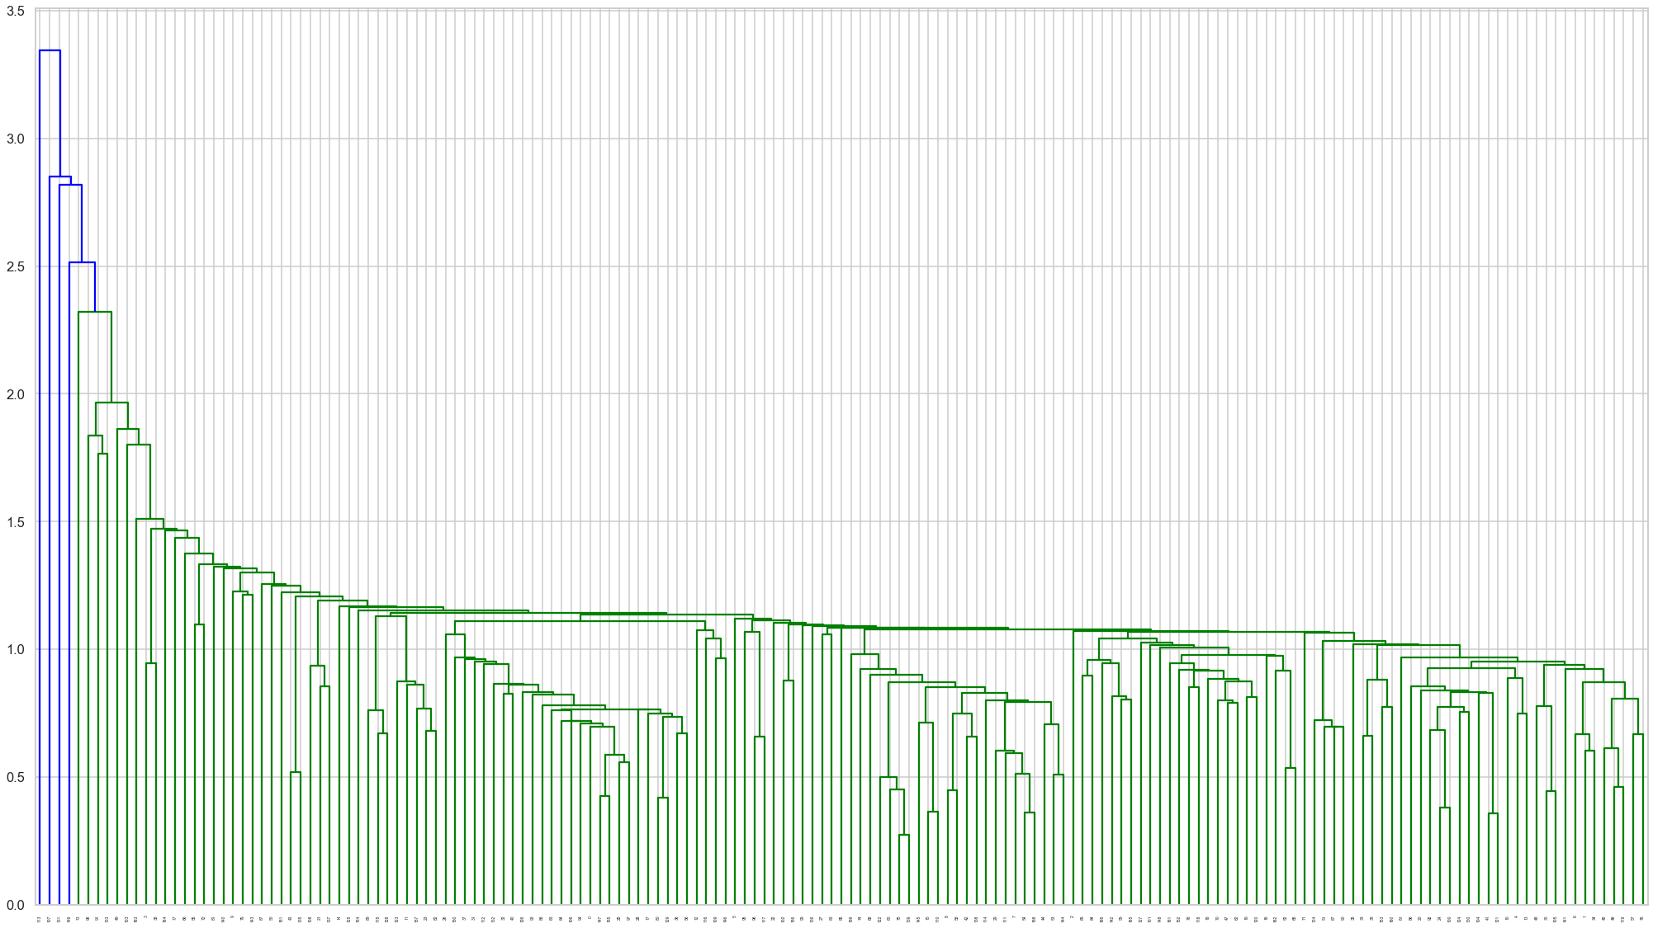
Single Linkage
In this method we can able to graph the dendrogram using single linkage.
But unfortunately it’s not quite visible and doesn’t suits for our dataset.
Also its difficult to cut the tree in a threshold value. Hence we will use complete linkage method.

Slide 11
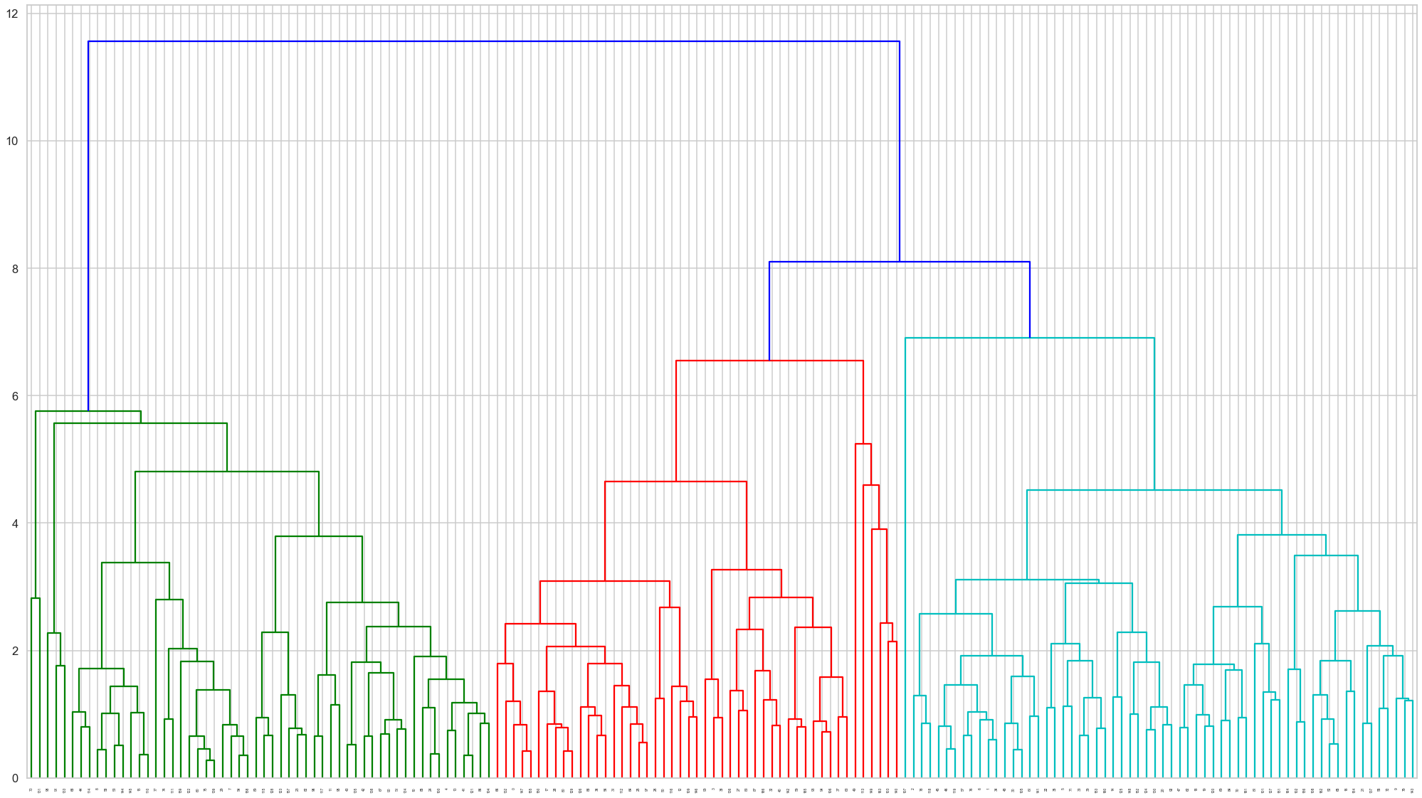
Complete Linkage
In this graph it is very much visible and helps us to deicide the no of clusters.
We can able to cut the tree at a threshold value
We can cut at value 3 which gives us 3 clusters.

Slide 12
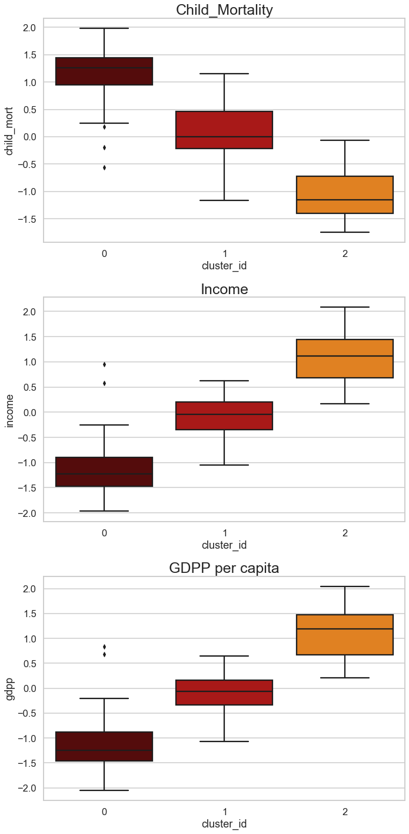
Box plot comparison among Child_Mortality, Income & GDPP
(Hierarchical Clustering)
Cluster id 0 has the high child mortality and also less
income & GDPP per capita
Cluster id 1 behaves normal in all features
Cluster id 2 has the low child mortality and high income
& GDPP per capita.
So we can consider the list of countries under Cluster id 0
There are 49 countries in cluster id 0 which needs immediate
aid of funding.

Slide 13
Insights from both clustering methods.
By applying both K-Means and Hierarchical Clustering methods on the given dataset. We found 50 countries which need aid (K-Means Clustering) and 49 countries which need aid by performing (Hierarchical Clustering) respectively.
we have done the experiment with the presence of outliers. If we exclude the outliers we may lose some important information's on the dataset. So we have executed the model with the presence of outliers.
After analyzing both the methods of clustering, I would choose to go with Hierarchical Clustering which results 49 countries as it gave more accurate numbers when compared to K-Means.

Slide 14
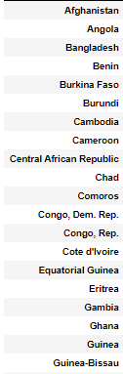
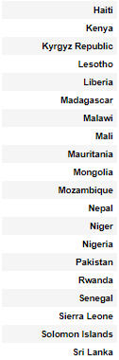
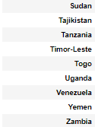
Conclusion
After executing both K-Means and Hierarchical Clustering methods, we have found that the results from Hierarchical Clustering method is more accurate and also this method fulfills the business requirement.

